Slide 1
VIA – An Introduction

Slide 2
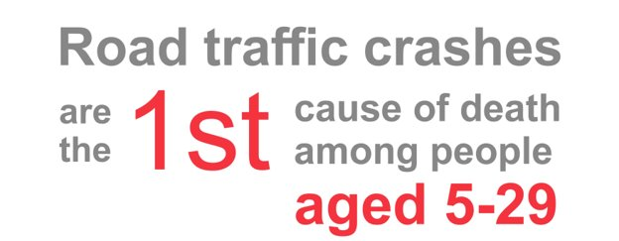
Why are children so vulnerable?
750 children die on the roads every day. And for every death, 10 more children are seriously injured.
In Asia, the roads kill more children aged 5-14 than diseases such as AIDS and malaria.
In poorer countries with less accessible health care systems and no social welfare, caring for injured children can send families into poverty.

Slide 3
Why are children so vulnerable?
Between 5-16 years, children progress through a number of stages in terms of their ability to negotiate the road environment safely; so the importance of tailoring a progressive approach to road skills training is crucial.
Children start school with different understandings of road safety.
Males and females also differ greatly.
When starting school, children have limited depth perception, scanning ability and their capacity to judge speed is poor.
They will be unable to strategically calculate risk in a traffic situation and are easily distracted such as by a ball or a friend.
Also, and quite simply, children are small. Their motor skills are not well developed. They move more slowly, with less precision. They are also difficult to predict, and for a motorist, they are very difficult to see.

Slide 4
Why are children so vulnerable?
As children grow their scan and search skills improve; so too does their conceptual understanding of danger.
However, their perceptive, information processing and psychomotor skills are still far from refined. And indeed, the very improvements they do feel may yield over-inflated confidence in their ability in and around the road environment.
Whilst such perception and motor skills become refined in adolescent children, that sense of over confidence is only prone to further inflation.
Add to that the exposure to more complex road safety situations, the independent responsibility for decision making and the new and powerful influence of peers.

Slide 5
Background to VIA
The Corporate Foundations of Michelin and Total joined to launch a major Road Safety Education Programme for children 10–18yrs.
This programme, developed with the support of Global Road Safety Partnership (GRSP), aims to directly reach 100,000 young people worldwide by end 2022.
Pilots began in 2019 in three countries and VIA has now expanded to 17 countries reaching over 18,000 students with over 3000 hours of structured education.
This programme can be deployed with local Implementing Partners (NGOs), police agencies or school teachers.
In the future more partners at a corporate level will be added to the project.

Slide 6
Background to VIA
The brief to develop VIA was ambitious – linked to a Safe System approach, the programme aims to be:
Flexible → engagement can be at different levels based on access time possible with students.
Easy to integrate → VIA can be incorporated to existing school road safety programmes without running the risk of duplication.
Cost Effective → the modular structure of the programme allows for an intervention tailored to budget.
Accessible → the programme is built to work in different contexts and can be customized to local languages and needs.
A Global Community → too often education programmes run in silos. VIA is different, implementors become part of a global VIA community to share experiences.

Slide 7
More about VIA

Slide 8
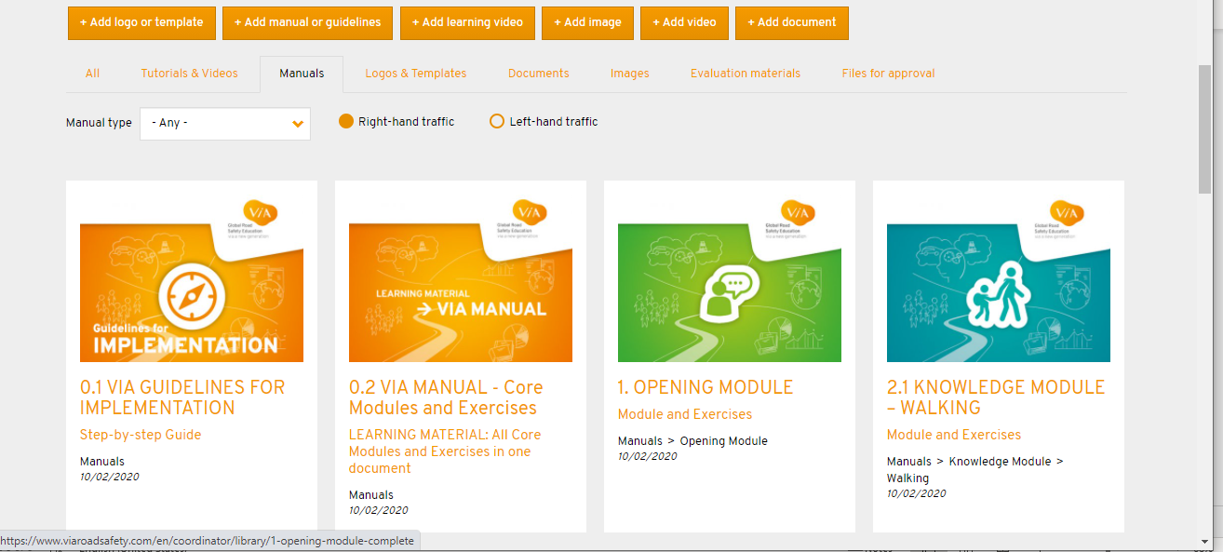
The VIA Tools
The library contains comprehensive manuals and guides which take Implementing Partners through the programme step by step.

Slide 9
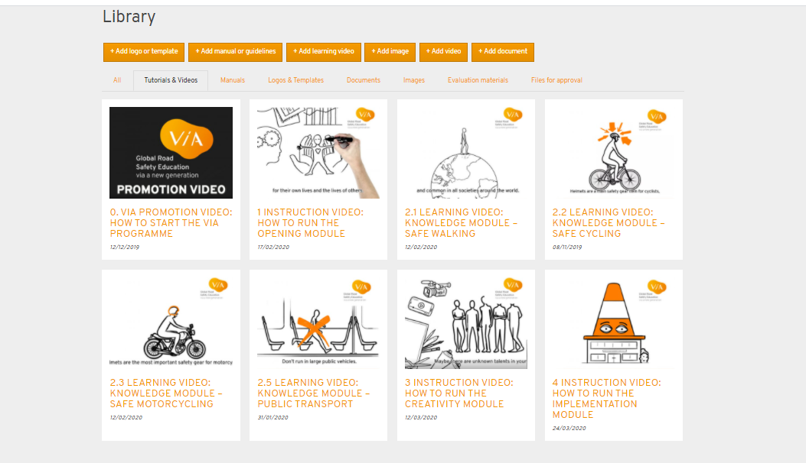
The VIA Tools
There are instructional videos for IPs on how to run each module as well as learning videos aimed at the children directly.

Slide 10
The VIA Tools
There is the VIA game which can be played online or offline.

Slide 11
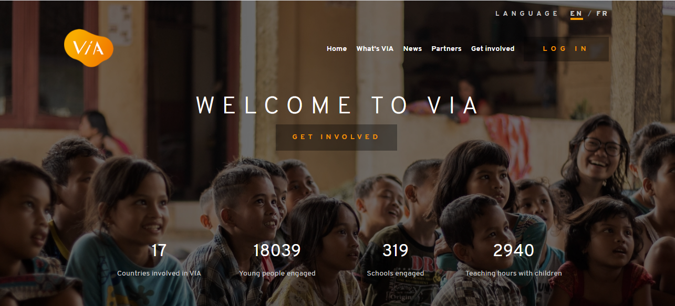
The VIA Tools
Every implementation is tracked through an online digital platform

Slide 12
The VIA Tools
Pre and post surveys contribute to national/global trend data by gender.

Slide 13
The VIA Community
Every VIA implementation and implementer is connected to the global VIA Community sharing successes and helping the programme evolve.

Slide 14
Links to road safety capacity building programme
Safer road users
Focus on road safety education and public awareness
Integration of road safety education within the safe system approach
Format: Webinars, technical training sessions and assignments
Target Audience: Road safety managers/coordinators, technical specialists, ADB staff
Key Modules (webinars and training):
Road Safety Management: July 12 – August 5
Safer Road Users: September 27 – October 21
Safer Roads and Mobility: Q1, 2022
Check for further updates on APRSO website - https://www.aprso.org/

